Slide 1



Affordable Legal and Identity Theft Solutions
For Individuals, Families and Businesses
Notes:
1. Choose the start slide of your preference and edit to ADD YOUR NAME
2. Thank your prospect for agreeing to meet with you and tell them you would like to walk them through some information to tell them more about what you do.
3. Tell them you are now working with the number one company in North America… LegalShield.
4. Continue by stating that LegalShield offers two services that we will be discussing today: Legal Protection and Identity Theft Protection.
NEXT SLIDE

Slide 2




Valuable Protection For You And Your Family Scott Brooks Independent Associate
Notes:
1. Choose the start slide of your preference and edit to ADD YOUR NAME
2. Thank your prospect for agreeing to meet with you and tell them you would like to walk them through some information to tell them more about what you do.
3. Tell them you are now working with the number one company in North America… LegalShield.
4. Continue by stating that LegalShield offers two services that we will be discussing today: Legal Protection and Identity Theft Protection.
NEXT SLIDE

Slide 3

Valuable Protection For Individuals, Families and Businesses. [ your name] Independent Associate
Notes:
1. Choose the start slide of your preference and edit to ADD YOUR NAME
2. Thank your prospect for agreeing to meet with you and tell them you would like to walk them through some information to tell them more about what you do.
3. Tell them you are now working with the number one company in North America… LegalShield.
4. Continue by stating that LegalShield offers two services that we will be discussing today: Legal Protection and Identity Theft Protection.
NEXT SLIDE

Slide 4

IN THE PAST THE LEGAL PROFESSION HAS BEEN KNOWN TO BE…
Expensive
Unresponsive
Unaccountable
Notes:
Begin by stating, “As you probably already know … The Legal Profession is notorious for being expensive, unresponsive and unaccountable.”

Slide 5

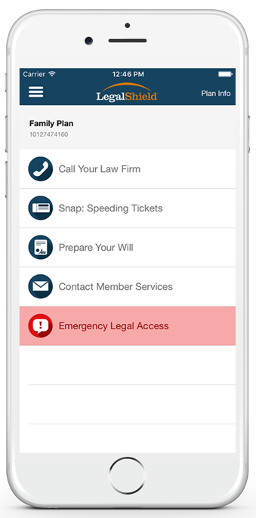
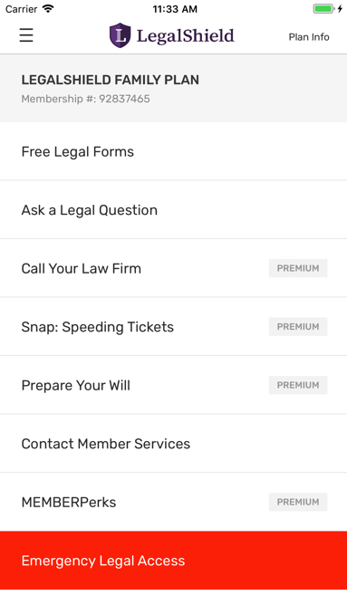

Introducing LegalShield
Affordable Legal Protection
Accountable Attorneys
Responsive Customer Service
Simpler. Easier. More affordable.
Notes:
“The LegalShield service and mobile app makes legal services affordable, accountable and responsive.”

Slide 6
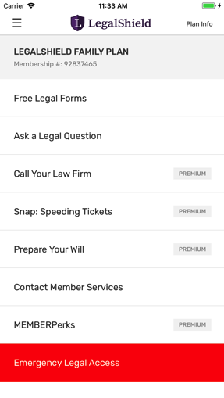

Introducing The LegalShield Services
Affordable Subscription On-Demand Legal Protection
Comprehensive Identity Theft Protection
Optional Home Business Supplement Coverage
Optional Gun Owner Supplement Coverage
Simpler. Easier. More affordable.
Notes:
EDIT AS NEEDED:
Optional slide that quickly shows an overview of what we offer, including the legal plan, ID Shield, home business supplement and the gun owner supplement.

Slide 7
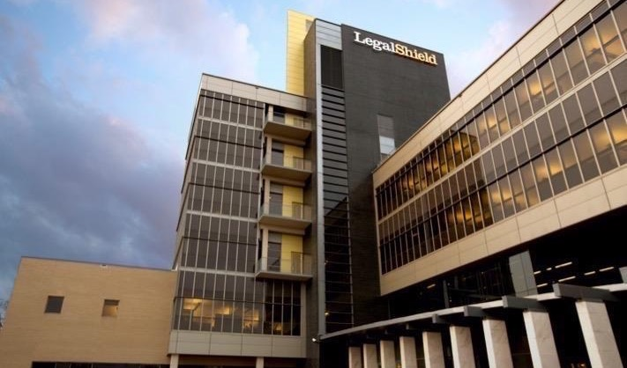



Our Company
Established in 1972.
Protecting approximately 4.6 million lives and 130,000 Businesses in the U.S. and Canada.
With a dedicated network of quality law firms in all 50 states and 4 Canadian provinces.
4.7
4.7
Notes:
Our company is a 45-year old company with incredible customer reviews. What these ratings means to me simple… People who use our service, love the service.

Slide 8
Common Legal Situations:
Consumer/Finance
Estate Planning
Traffic
Family Law
Landlord/Tenant
Real Estate
Employment
Civil Litigation
Collection
General Law
Business
Criminal
Contract
Personal Injury
Immigration
Notes:
Establish the NEED for common everyday legal services by simply reviewing some of the most common types of legal matters that everyone faces from time to time.

Slide 9

WE ALL NEED ACCESS TO AFFORDABLE LEGAL SERVICES.
The need
For Example, Have You Ever…
Signed a contract or a document?
Wanted to create a will?
Had a landlord not refund your security deposit?
Received a traffic ticket?
Been in a situation where you thought the advice of a lawyer might be useful?
9
Notes:
Use this slide to help address, “why would I need an attorney?”. You want to establish that although your prospect may not have used attorneys in the past… they might have and they could have if they were easier to access and more affordable.

Slide 10

The Main Reasons people Don’t Seek Legal Counsel
The NEED
They are intimidated by lawyers
They don’t know who to call
They believe it would cost too much
The Most Common Responses to a Legal Dispute
Ignore the problem
Try to handle it personally
Source: The Legal Needs of American Families. A Research Study Conducted by Decision Analyst, Inc. Commissioned by LegalShield
Notes:
SIMPLE READ THROUGH SLIDE IN AN EDUCATIONAL TONE: Explains the reasons people do not use legal services more often.

Slide 11
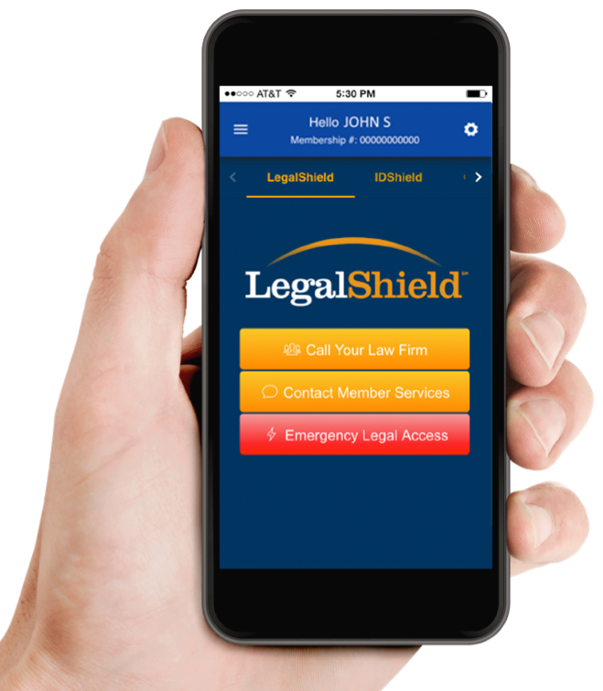


With LegalShield Just Tap. Call. Get Equal Access.
Schedule Of Services:
Unlimited Legal Advice & Consultation
Contract and Document Review Service
Attorney Generated Letters and Phone Calls To Help Resolve Disputes/Concerns
Legal Forms and Contracts Generator
IRS Audit Assistance (50 hrs. per year)
Civil Trial Defense Protection (60 hrs. +++++)
Exclusions and limitations apply. Services and benefits vary by state/province.
See www.legalshield.com/fullplandetails [and select your state/province] for specifics.
Please review a contract for complete terms, conditions and exclusions before purchase.
Notes:
Now lets get into what a LegalShield membership covers. Review the Schedule of Services. Give brief examples of how someone might use them. (or how you have used them)
How did Patrick tie each of these things to the app in his presentation. Fisher Price it here and do the same for the audience.

Slide 12

FAMILY SERVICES
Family/Domestic Services:
(90 day waiting period)
Uncontested Divorce
Uncontested Adoption
Uncontested Separation/Annulment
Uncontested Name Change
12
Notes:
Review the Family Domestic Legal Services

Slide 13
70%
Did you Know that nearly 70% Of American families don’t have an updated will?
LegalShield Members have easy and affordable access to our
estate planning attorney’s.
13
Notes:
This is a set up slide to introduce our Will preparation service on the next slide. Chances are, your prospect will be in the 70% of those that do not have an updated will and this could be the easiest point of entry for them to get started.

Slide 14
Tap. Download. Complete.
Schedule Of Services: (Cont’d)
Lawyers Prepare Your:
Last Will
Living Will
Healthcare Power of Attorney
Durable Power of Attorney
Exclusions and limitations apply. Services and benefits vary by state/province.
See www.legalshield.com/fullplandetails [and select your state/province] for specifics.
Please review a contract for complete terms, conditions and exclusions before purchase.
Notes:
Explain the estate planning services and review what is covered in an educational tone.

Slide 15
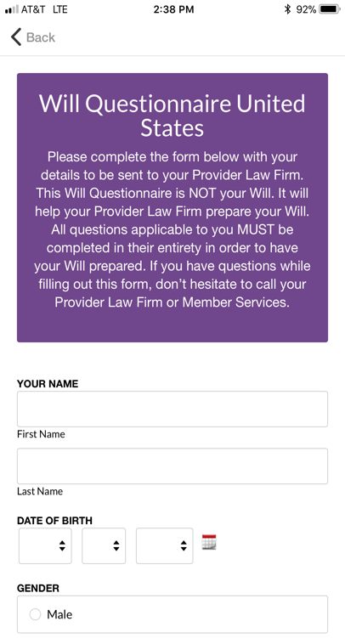
Tap. Download. Complete.
Schedule Of Services: (Cont’d)
Just push a button and start on your Will!
Or, if you prefer, you can complete our standard will questionnaire form.
Exclusions and limitations apply. Services and benefits vary by state/province.
See www.legalshield.com/fullplandetails [and select your state/province] for specifics.
Please review a contract for complete terms, conditions and exclusions before purchase.
Notes:
Review how easy it is to get the process started for updating or creating your will with our service. You can use the mobile app to answer the initial will questionnaire and submit your answers to the law firm or you can fill out a paper will questionnaire and upload it to the law firm. Either way its easy!

Slide 16
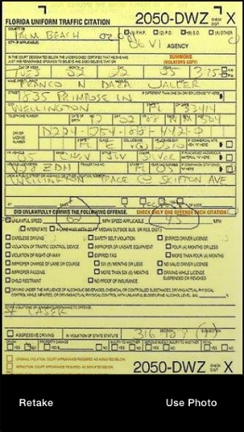
Tap. Snap. Send.
Schedule Of Services: (Cont’d)
Traffic Citation Legal Assistance
Ticket and Member info submitted to YOUR law firm
Consultation within 8 business hours
Representation in any courtroom in the U.S.
Criminal Charges Excluded
Exclusions and limitations apply. Services and benefits vary by state/province.
See www.legalshield.com/fullplandetails [and select your state/province] for specifics.
Please review a contract for complete terms, conditions and exclusions before purchase.
Notes:
Explain the traffic citation services: Tell your prospect … ALSO INCLUDED IN THE MEMBERSHIP IS OUR: Traffic Citation and Legal Assistance for those times when you or a family member might get a ticket… then explain the coverage on the slide.

Slide 17
Tap. Call. Access.
Schedule Of Services: (Cont’d)
24/7 Emergency Access Anytime You Feel Your Rights Are Being Violated
Exclusions and limitations apply. Services and benefits vary by state/province.
See www.legalshield.com/fullplandetails [and select your state/province] for specifics.
Please review a contract for complete terms, conditions and exclusions before purchase.
Notes:
Review the 24/7 coverage. State that last year our attorneys took over 60,000 after hour phone calls. This service can be used anytime you or a family member has an emergency or feels that your legal rights are being violated. Just pick up the phone and tap the emergency legal access button on the app. You will be connected to an after hours attorney in a matter of minutes.

Slide 18

Schedule Of Services: (Cont’d)
25% Preferred Member Discount
DUI
Bankruptcy
Contested Adoption
Contested Divorce
Plaintiff In A Lawsuit
Preexisting Legal Matters
Criminal Charges
Other Matters Not Covered
Exclusions and limitations apply. Services and benefits vary by state/province. See www.legalshield.com/fullplandetails [and select your state/province] for specifics. Please review a contract for complete terms, conditions and exclusions before purchase.
Notes:
Tell the prospect: The coverage's I have outlined were designed to handle over 90% of what the average person needs from a law firm. But for the other 10% of legal matters that are not covered 100% you will never have to pay full price. Chances are you will never even need these services but if you need them they will be there… For all other areas that might not be covered under the plan.

Slide 19
























Schedule Of Services: (Cont’d)
Get Member Discounts With Member PERKS!
Tap. Access. Save.
Take advantage of the savings with MemberPERKS!
These benefits are for LegalShield and IDShield members. All offers or promotions are subject to change without notice.
Notes:
Tell the member that “INCLUDED IN YOUR MEMBERSHIP IS THE MEMBERPERKS DISCOUNT PLAN”. Explain to the prospect how they can literally get the service for free by using a few of the many Member Perks discounts that automatically come with the membership. Some of the more popular MemberPerks are the 8% Verizon Wireless discount, movie tickets, car rentals, hotels, Men’s Wearhouse and more.

Slide 20

Who’s Covered
The member
The member’s spouse
Never-married dependent children under age 26 living at home or full-time student
Dependent children under age 18 for whom the member is legal guardian
Physically or mentally disabled children living at home
Notes:
Tell them you is covered. Read the slide.

Slide 21

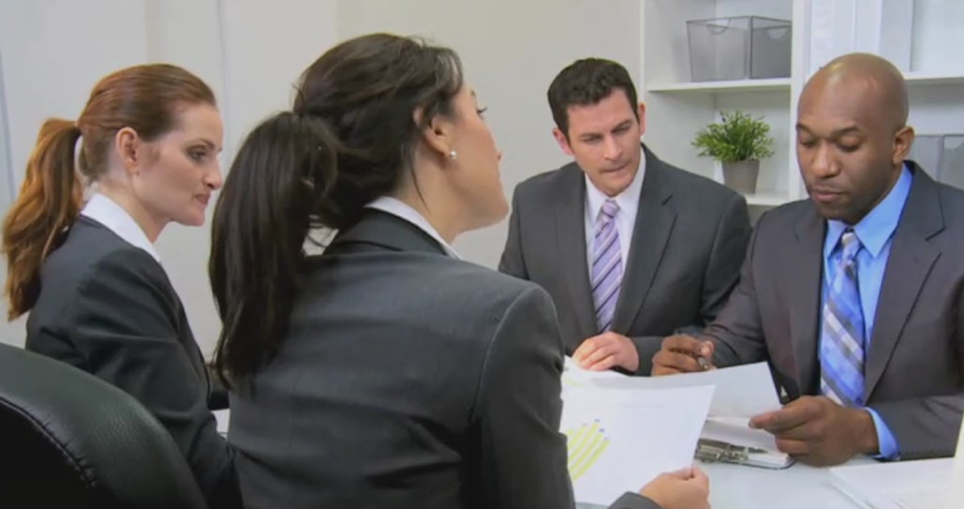


6500+ ATTORNEYS NATIONWIDE
Our Attorneys Have The Highest Possible Rating
Notes:
You will be happy to know that we have over 6500 attorneys nationwide and ALL of our attorneys must have the AV PREEMINENT RATING from Martindale and Hubble for ethical standards and legal ability in order to be considered as one of our provider law firms. This is the highest rating an attorney can achieve in the U.S. for high ethical standings.

Slide 22
6500+ ATTORNEYS NATIONWIDE
Our Attorneys Have The Highest Possible Rating
Your Preferred Provider Attorney's
Merritt, Webb, Caruso, Attorneys
North Carolina Preferred Provider
1990
YEAR FOUNDED
1999
JOINED LEGALSHIELD
32
AVERAGE YEARS OF EXPERIENCE
Notes:
(OPTIONAL) Edit this slide as needed by looking up the provider law firm in the “States At A Glance” directory for the business state you are presenting
How to access “States At A Glance”
Note: You must be a LegalShield associates to use these to access the AOBO portal.
Login the AOBO at: online.legalshield.com
Click on : My Business | Tools | States At A Glance
Find the Provider Lawfirm In The State You Are Presenting In

Slide 23


Which Would You Choose?
A Lawyer Charging
$250/HOUR
Join LegalShield for
Less Than $25/mo.
Notes:
When you click to this slide you might say something like, “now that I have shown you how powerful a LegalShield membership… which would you choose if you had the choice?” Read the slide. The point is to bring them to the obvious conclusion that this is just a better solution. Even if they only use it 1-2 times per year to get advice or to deal with a ticket, it will save them money.

Slide 24
With all the recent Data Breaches,
Scams, and Other Concerns… there is another HUGE problem that everyone faces:
IDENTITY THEFT
Criminals don’t want your money. THEY WANT YOUR IDENTITY.
Notes:
Transition to talking about our Identity Theft Protection Service… ID Shield. Tell your prospect, Now let’s talk about identity theft for a few minutes.

Slide 25
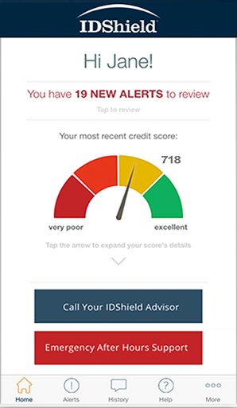
Common types of Identity Theft:
IRS Tax Return ID Theft
Medical Insurance ID Fraud
Social Security Fraud
Credit Card ID Theft
Driver’s License
Criminal/Character
FACT: Most of these issues cannot be detected with just a credit monitoring plan.
FACT: ID Theft is the #1 Crime in America.
FACT: You are guilty until proven innocent!
FACT: ID Shield Offers The Best Protection!
Notes:
Review the info on the slide in an educational tone. Like an educator.

Slide 26

Included Monitoring & Alert Services
Credit Score
SSN
Passport
Drivers License
Medical ID Info
Email
Loans
Credit Cards
Bank Accounts
Black Market Website Surveillance
Social Media
FACT: ID Shield offers the best coverage at the best price.
Notes:
Tell the prospect: “Here is a list of everything that is included in the IDShield monitoring and alert services…. Review the slide.

Slide 27

The Best Comprehensive Restoration
Our Licensed private investigators will:
Do whatever it takes
As long as it takes
Restore identity to its pre-theft status
Up to $5 Million Dollars
FACT: No other service in North America offers this level of protection.
Notes:
Inform the prospect that, “The reason IDShield is the best solution in the market today is simply because they offer comprehensive restoration services… READ THE SLIDE!

Slide 28


What Your Benefit Includes:
Free credit score and analysis
Credit counseling assistance
Credit monitoring and alerts
Personal ID monitoring and alerts
Quarterly Credit Score Tracker
Unlimited Identity Theft consultation
Comprehensive Identity Restoration
$5 Million Service Guarantee
$9.95/mo. Individual (Per Person)
$24.95/mo. Family Rate (up to eight dependents)
28
Notes:
QUICK SUMMARY IN REVIEW OF WHATS COVERED IN THE IDSHIELD. READ Through quickly. Review the rates at the bottom.

Slide 29

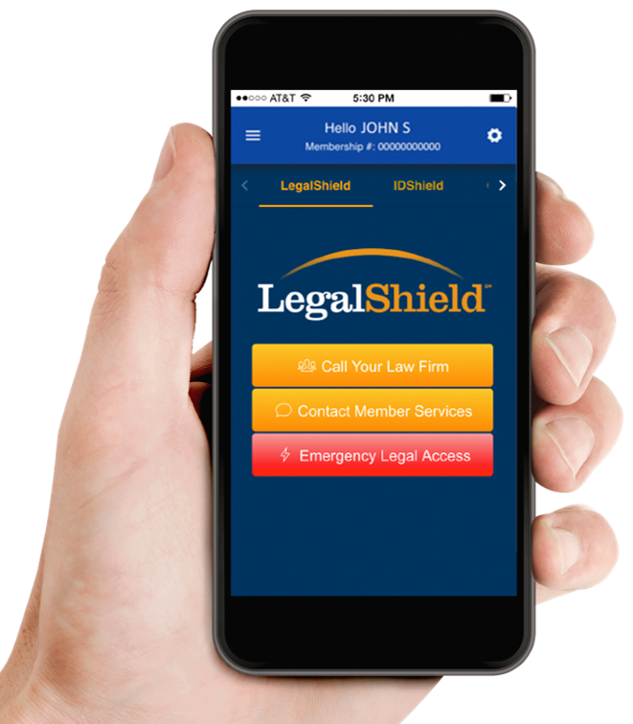



Affordable Monthly Rates
= $49.90/month
($24.95 LegalShield + $24.95 ID Shield)
FULL FAMILY PROTECTION
= $34.90/month
($24.95 LegalShield + $9.95 ID Shield)
INDIVIDUAL
29
Notes:
Tell your client: Many of our clients subscribe to both the LegalShield and IDShield but you can enroll in just one plan or the other as well. Review the pricing scenarios on the page.
NOTE THIS IS NOT THE EMPLOYEE DISCOUTNED RATES

Slide 30
Frequently Asked Questions: Everything You Need To Know.
No Long Term Contracts – Month to Month agreement can be easily changed
Set Up Through A Convenient Monthly Bank Draft or CC Deduction
Your Rates Are Locked In Today…
You Will Receive A Digital Enrollment Confirmation Email with Links To Activate your benefit within 1-3 business days.
You can start using your services immediately.
Notes:
Review the FAQ’s before asking if they have any questions about the services you have reviewed. State: Before I conclude let me review a few Frequently Asked Questions. Simply read the bullets.

Slide 31

Action Steps
Become a LegalShield Member Complete your application. Set up your account online at www.mylegalshield.com
Become an ID Shield Member Complete your application. Set up your account online at www.myidshield.com
Wait For Your Digital Enrollment Kit Via Email.
Download The Mobile Apps
Start Using Your Membership!
Notes:
OPTIONAL: ANOTHER REVIEW OF THE ACTION STEPS TO GET STARTED

Slide 32

Hopefully I have been able to show you value today with these affordable services…
Is there Any Reason You Would Not Want To Start Protecting Yourself and Your Family With These Valuable Services?
Notes:
Be sure to close the sales presentation by asking for a commitment to get started. This is a non-threatening and non-confrontive sales close. Ask them… is there any reason….
If they agree to enroll you can wither fill out a paper application and talk with your upline sponsor or coach to learn how to properly submit the application for processing.
Another option is to complete your application online using your AOBO or your LegalShield marketing website (for LegalShield associates only)
Login the AOBO at: online.legalshield.com
From the dashboard click on : SUBMIT APPLICATION
Follow the online application prompts to complete
OR you can go to your marketing website at xxxxxxxxxx.wearelegalshield.com (xxxxxxxxx = your LegalShield associate username)

Slide 33

Thank You The Highest Compliment I Can Receive Is The Personal Referral Of Your Friends, Family, and Business Associates. Who Do You Know That Might Need These Valuable Services?

Slide 34
OPTIONAL SLIDES (Copy and Insert AS NEEDED)

Slide 35


Gun Owners Supplement
Emergency Access For A Firearm Incident* 24/7 toll-free access to a provider lawyer for consultation in the event of an off-duty firearm incident
Trial Defense for Gun Related Matters
Defense of covered civil and criminal lawsuits filed in state or federal court 60 total hours for covered lawsuits (20 hours pre-trial and 40 hours trial per plan year)
Advice and Consultation , Gun owner rights, Carry and license requirements, Recent changes in gun laws
NFA Gun Trust Services - One (1) NFA Gun Trust prepared by your provider law firm per membership year for a flat fee of $250
For An Additional $12.95/mo.
Covers member and spouse
Notes:
Individual Rate (non employee discount)

Slide 36

Home Business Supplement
Whether you own a home business, are a consultant or need business legal advice, you can add the HBS (Home Business Supplement) to your personal legal plan.
Advice – Phone consultation and advice for any business related matter.
Legal Document Review – Up to three (3) business contracts or documents reviewed per month.
Letters and Phone Calls On Your Business’ Behalf – Up to six (6) attorney written letters or calls per year.
Debt Collection Assistance – Up to three (3) debt collection letters written per month.
IRS Audit Services – IRS audit services include schedule C and E (attached to members personal return)
For An Additional $9.95/mo.
Covers up to 3 home based businesses
36
Notes:
Individual Rate (non employee discount)

Slide 37

Notes:
Optional Fact slides about the recent Equifax Data Breach and the importance of having Identity theft protection.

Slide 38
The FACTS
Equifax is one of the 3 major
credit bureaus and as such has
access to some of the most
sensitive information
Notes:
Optional Fact slides about the recent Equifax Data Breach and the importance of having Identity theft protection.

Slide 39
The FACTS
Equifax data was hacked in
July 2017
Thieves stole 143 million
Individual data files
(44% of the population)
Notes:
Optional Fact slides about the recent Equifax Data Breach and the importance of having Identity theft protection.

Slide 40
The FACTS
They got: names, addresses,
social security numbers, drivers
license numbers, DOB, banking
and credit card information
Notes:
Optional Fact slides about the recent Equifax Data Breach and the importance of having Identity theft protection.

Slide 41
The FACTS
This is the worse data breach in
U.S. history both in size and
scope.
(the amount of sensitive data that was obtained.)
US Dept. Of Terrorism
Notes:
Optional Fact slides about the recent Equifax Data Breach and the importance of having Identity theft protection.

